Slide 1
Analyzing the problem
(Fall 2019)
Software Requirements Analysis
Week 3
Software Requirements Analysis

Slide 2
Agenda for this Lecture
Brief review of the previous lecture
Why to do Problem Analysis
Definition of Problem Analysis
How to address the problem
Discussion about project idea
Key Points
Next?
Software Requirements Analysis

Slide 3
Agenda for this Lecture
Brief review of the previous lecture
Why to do Problem Analysis
Definition of Problem Analysis
How to address the problem
Discussion about project idea
Key Points
Next?
Software Requirements Analysis

Slide 4
Review
What are Requirements …?
  Definition
  Their Importance
  Classification
What are Requirements Management …?
Phases of the Requirements Development Process: …?
Role of the Team in Requirements Development …?
Software Requirements Analysis

Slide 5
Agenda for this Lecture
Brief review of the previous lecture
Why to do Problem Analysis
Definition of Problem Analysis
How to address the problem
Discussion about project idea
Key Points
Next?
Software Requirements Analysis

Slide 6
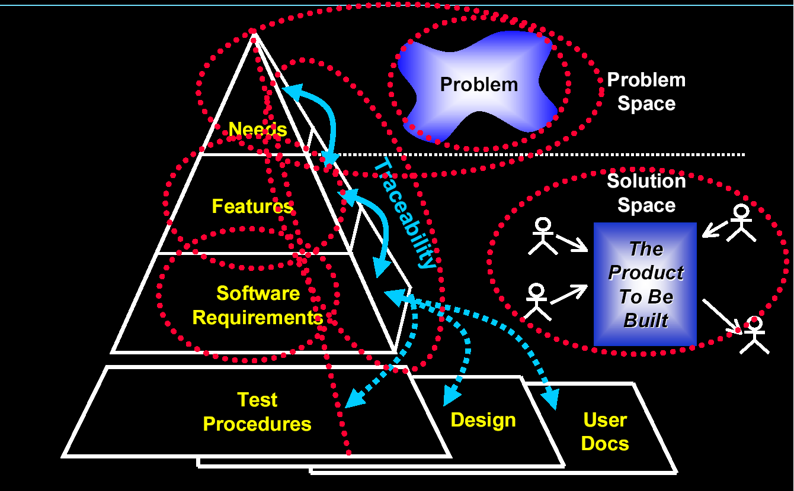
Requirements management: Overview
(extracted from the slides of Peter Hauker, Rational)
Software Requirements Analysis: Introduction

Slide 7
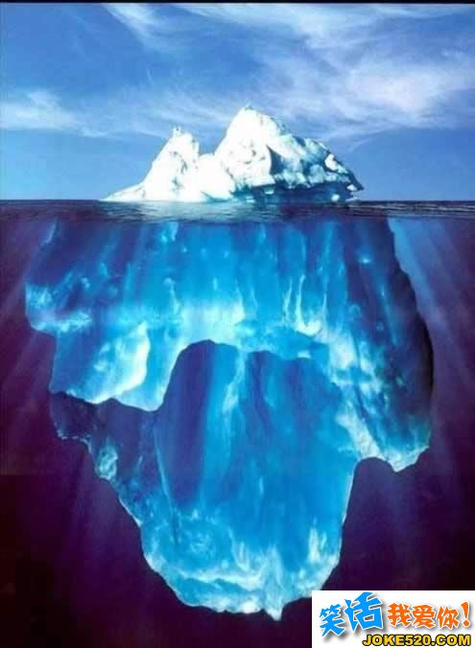
要求、问题与需求
客户表面的要求
客户背后的问题
要求
问题
客户隐藏的真实
需求
需求
透过客户的要求，发现背后的客户问题，
而挖掘出客户的真正需求！

Slide 8
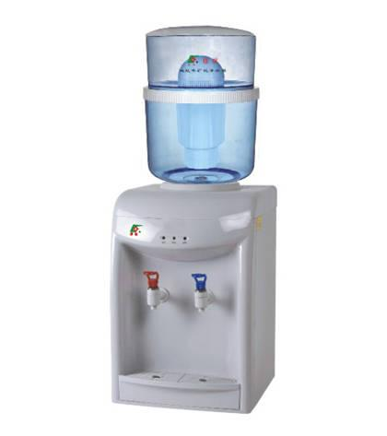
案例研究：
客户要求: 我家人口少，桶装水一桶通常要喝一个多月才能
喝光，我希望今后的水桶采用纳米材料，防止细菌的滋生。
当时公司市场部人员感觉这是一条十分重要的信息，就对
这一需求进行了相当规模的客户调研，然后公司决定花大
力气去研发纳米桶来装水。
然而产品上市后的反应不尽人意
这是为什么？
Notes:
《别掉进“消费者陷阱”》 销售与市场杂志 2007年第7期

Slide 9
案例研究：
水桶采取纳米材料
水喝不完，水桶会滋生细菌
要求
问题
对饮水安全的
担忧
需求
在这个案例中，客户的要求只是针对客户需求的一种解决方案，而不是客户的真正需求！

Slide 10

分组讨论：为什么纳米水桶在市场上失败了？
_{15’}
请分析原因
如果你们组收集到这个信息，如何处理？
Software Requirements Analysis

Slide 11
Agenda for this Lecture
Brief review of the previous lecture
Why to do Problem Analysis
Definition of Problem Analysis
How to address the problem
Discussion about project idea
Key Points
Next?
Software Requirements Analysis

Slide 12
Definition
Problem Analysis is:
the process of understanding real-world problems and user needs and proposing solutions to meet those needs
Software Requirements Analysis

Slide 13
Agenda for this Lecture
Brief review of the previous lecture
Why to do Problem Analysis
Definition of Problem Analysis
How to address the problem
Discussion about project idea
Key Points
Next?
Software Requirements Analysis

Slide 14
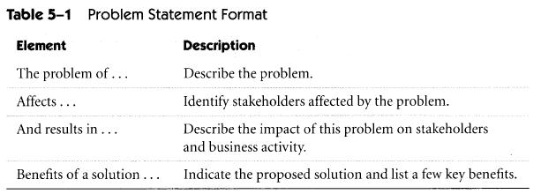
Step 1: Gain agreement on the problem definition
Write Problem Definition
Gain agreement
Software Requirements Analysis

Slide 15
Step 2: Understand the Root Causes
Root Cause Definition
An identified reason for the presence of a defect or problem.
The most basic reason, which if eliminated, would prevent recurrence.
The source or origin of an event.
Software Requirements Analysis

Slide 16
Step 2: Understand the Root Causes
Root Cause Analysis
  basic and contributing causes are discovered in a process similar to diagnosis of disease.
The goal is to find out:
  what happened
  why did it happen
  what do you do to prevent it from happening again.
Software Requirements Analysis
Notes:
- with the goal always in mind of preventing recurrence

Slide 17

Step 2: Understand the Root Causes (cont.)
Example
Problem:
“Last summer, we noticed that several trees appeared to be dying”
Cause:
  decorative plant beds were suffocating the tree roots
Solution:
  remove plant beds
  Sod is the best choice to place around a tree
Software Requirements Analysis
Notes:
- with the goal always in mind of preventing recurrence

Slide 18

Step 2: Understand the Root Causes (cont.)
A Classical Example:
a pool of oil on the factory floor
Day 1:
  clean it up!
Day 2: exactly the same pool of oil in the same place
  follows a predictable scenario of blame and resentment
Day 3: more oil !?!
And so on …
oil
Plant Manager
Software Requirements Analysis
Notes:
- with the goal always in mind of preventing recurrence

Slide 19

Step 2: Understand the Root Causes (cont.)
A pool of oil on the factory floor -
Root Cause Analysis approach:
Day 1:
  why the oil was there at all ?
Cause 1: a leaking gasket in the pipe above
Cause 1.1: supplier's gaskets had a bad record of leakage but that they had been selected as a supplier of choice because of the low price
  why economy was used as the deciding criterion for selection of equipment?
Cause 1.1.1: the directive from the Product Manager had been to be "extremely cost conscious".
Moral: the Plant Manager was responsible for the oil pool himself
oil
Plant Manager
Software Requirements Analysis
Notes:
- The advantages of root cause analysis resemble those of other quality initiatives. The incremental approach of the process can lead to the identification of barriers and causes of problems which will ultimately lead to permanent solutions. Using root cause analysis can establish repeatable step by step processes, that can be mapped and can then be documented and repeated as necessary.

Slide 20
Sample Problem: GoodsAreUs
“… a mail-order catalog company … sells a variety of inexpensive, miscellaneous items for home and personal use.”
Problem: insufficient profitability
  Cause 1: the problem is due to the high cost of nonconformance
    Cause 1.1: Largest contributor is Excess Scrap
The problem behind the problem in scrap?
Software Requirements Analysis

Slide 21
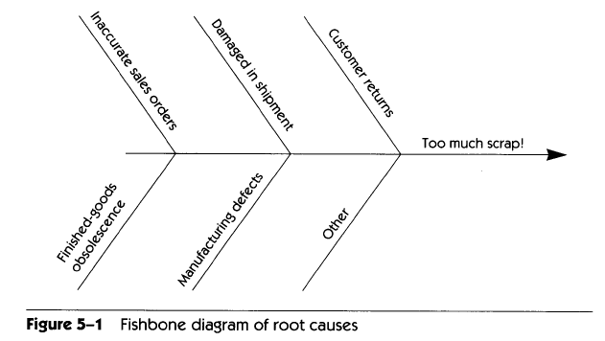
Step 2: Understand the Root Causes (cont.)
Technique: Fishbone Diagram
GoodsAreUs
Software Requirements Analysis

Slide 22
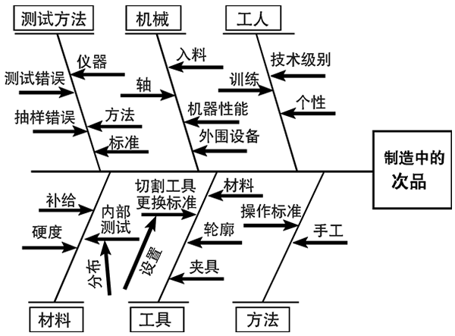
Step 2: Understand the Root Causes (cont.)
Example of Fishbone Diagram
Software Requirements Analysis

Slide 23
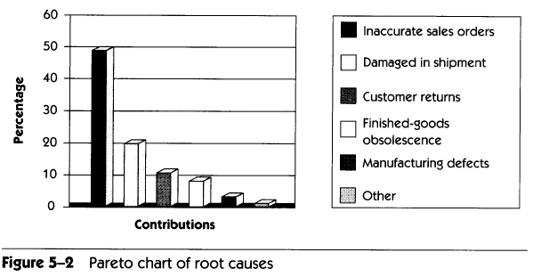
Step 2: Understand the Root Causes (cont.)
Prioritize the contributions of the causes
  Cost-benefit analysis of fixing the causes
Technique: Pareto Chart
GoodsAreUs:
Software Requirements Analysis

Slide 24
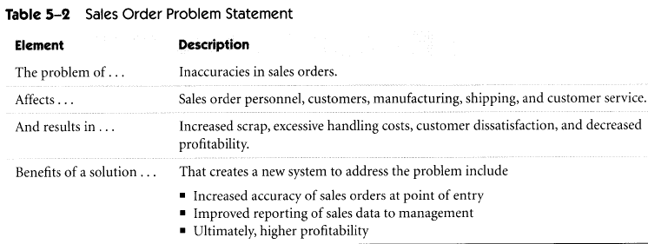
Step 2: Understand the Root Causes (cont.)
Problem Statement:
  Output from the step 2
  Given to the stakeholders for comments and feedback
  GoodsAreUs :
Software Requirements Analysis

Slide 25
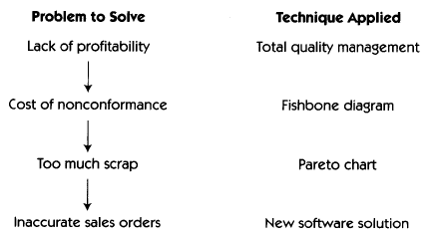
Step 2: Overview
Summary:
Looking ahead:
  apply fishbone analysis to determine specific types of errors that contribute to the problem
  Use this data to define the features of the system to address those errors
Software Requirements Analysis

Slide 26
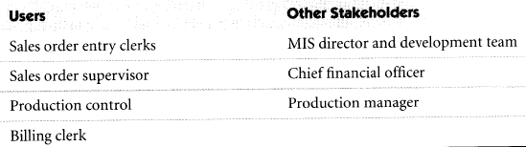
Step 3: Identify the Stakeholders and the Users
Stakeholder:
  Anyone who could be materially affected by the implementation of a new system or application
GoodsAreUs :
Software Requirements Analysis

Slide 27
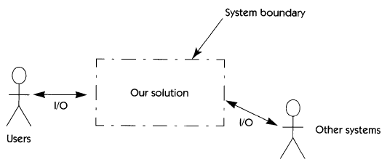
Step 4: Define the Solution System Boundary
System Boundary:
  defines the border between the Solution (our system) and the Real World (things that interact with our system)
Actor:
  someone or something outside the system that interacts with the system
Software Requirements Analysis

Slide 28
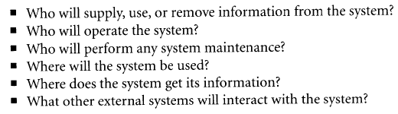
Step 4: Define the Solution System Boundary (cont.)
How to identify the actors?
  The following questions might be helpful:
Software Requirements Analysis

Slide 29
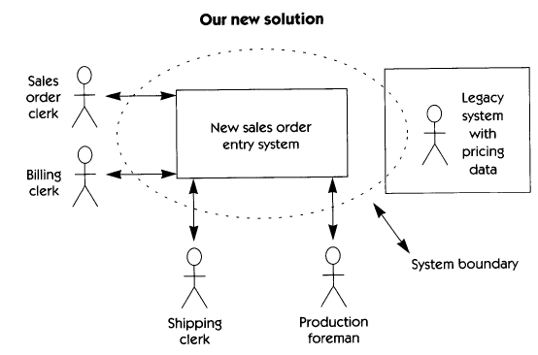
Step 4: Define the Solution System Boundary (cont.)
GoodsAreUs :
Software Requirements Analysis

Slide 30
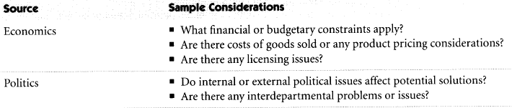
Step 5: Identify the Constraints to be Imposed on the Solution
Constraint:
  A restriction on the degree of freedom we have in providing a solution
Potential Sources of System Constraints:
Software Requirements Analysis

Slide 31
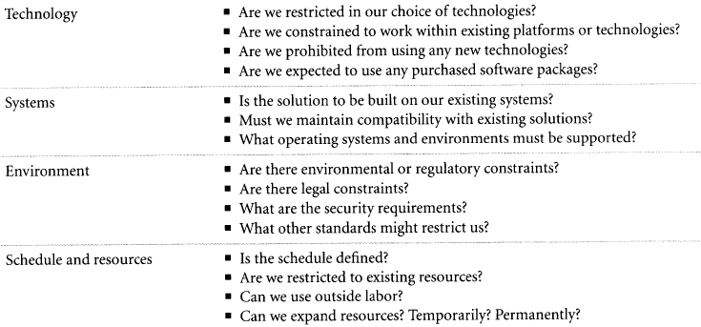
Step 5: Identify the Constraints to be Imposed on the Solution (cont.)
Potential Sources of System Constraints (cont.):
Software Requirements Analysis

Slide 32
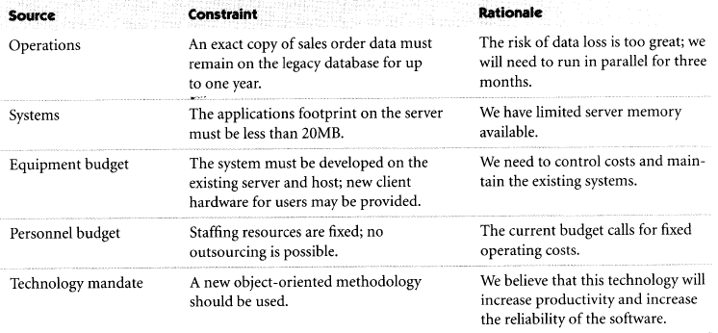
Step 5: Identify the Constraints to be Imposed on the Solution (cont.)
GoodsAreUs :
Software Requirements Analysis

Slide 33
Specific Problem Analysis Techniques
Business modeling
  Applicable to IS/IT applications
Systems Engineering
  Applicable to software-intensive systems in the embedded-system domain
Software Requirements Analysis

Slide 34
Business Modeling
Purpose:
  To understand the structure and dynamics of the existing organization
  To ensure customers, end users and developers have a common understanding of the organization
  To understand how to deploy new systems and which existing systems may be affected by that new system
Software Requirements Analysis

Slide 35
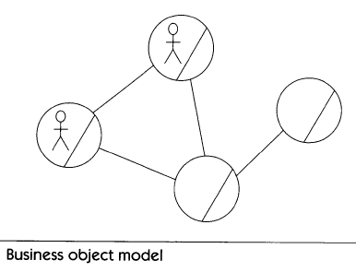
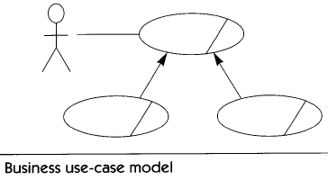
Business Modeling (cont.)
SE techniques for business modeling:
Software Requirements Analysis

Slide 36
Systems Engineering
System decomposition process
Derived requirements:
  Subsystem requirements
    Example: “Subsystem A must execute the algorithm that computes the wind speed of the aircraft”
  Interface requirements
    Interfaces between the subsystems to communicate with one another to accomplish an overall result
    Example: “Subsystem A delivers the results of the wind speed computation in the following format: ….”
Software Requirements Analysis

Slide 37
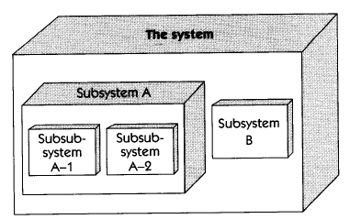
System Decomposition
Software Requirements Analysis

Slide 38
Discussion
Define the system boundary of your project.
Submit the discussion result on cc.scu.edu.cn
Software Requirements Analysis

Slide 39
Key Points?
Problem Analysis is the process of understanding:
  real-world problems
  User’s needs
before development begins!
Problem Analysis proposes solutions to meet those needs
Software Requirements Analysis

Slide 40
Next?
Understanding User and Stakeholder Needs
  Challenges of requirements elicitation
  Techniques for eliciting requirements:
    Interviews and questionnaires
    Requirements workshop
    Brainstorming sessions and idea reduction
    Storyboards
Software Requirements Analysis

